Slide 1
Asynchronous Counter Operation

Slide 2
Introduction: Counters
Counters are circuits that cycle through a specified number of states.
Two types of counters:
synchronous (parallel) counters
asynchronous (ripple) counters
Ripple counters allow some flip-flop outputs to be used as a source of clock for other flip-flops.
Synchronous counters apply the same clock to all flip-flops.

Slide 3
Asynchronous (Ripple) Counters
Asynchronous counters: the flip-flops do not change states at exactly the same time as they do not have a common clock pulse.
Also known as ripple counters, as the input clock pulse “ripples” through the counter – cumulative delay is a drawback.
n flip-flops → a MOD (modulus) 2^{n} counter. (Note: A MOD-x counter cycles through x states.)
Output of the last flip-flop (MSB) divides the input clock frequency by the MOD number of the counter, hence a counter is also a frequency divider.

Slide 4
Asyn. Counters with MOD no. < 2^{n}
States may be skipped resulting in a truncated sequence.
Technique: force counter to recycle before going through all of the states in the binary sequence.
Example: Given the following circuit, determine the counting sequence (and hence the modulus no.)
C
B
A
Q
J
Q
J
Q
J
All J, K inputs are 1 (HIGH).
CLK
CLK
CLK
Q
K
Q
K
Q
K
CLR
CLR
CLR
B
C

Slide 5
Asynchronous Counter Operation
Asynchronous binary counter
2-bit asynchronous binary counter
3-bit asynchronous binary counter
4-bit asynchronous binary counter
Asynchronous decade counter

Slide 6
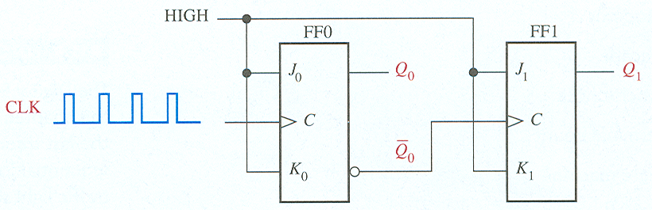
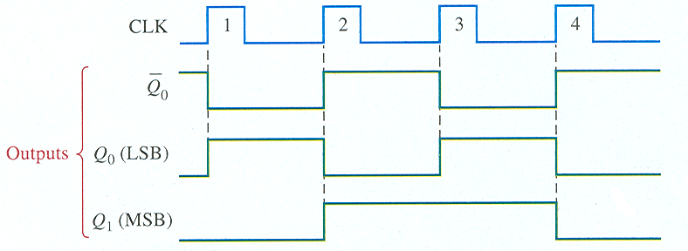
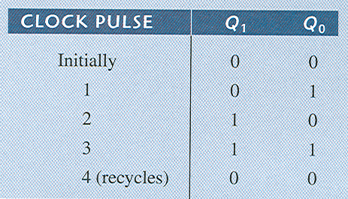
Asynchronous Counter Operation
2-bit asynchronous binary counter

Slide 7
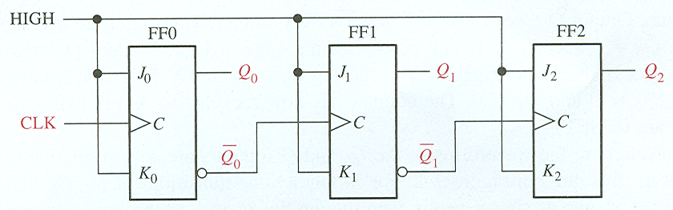
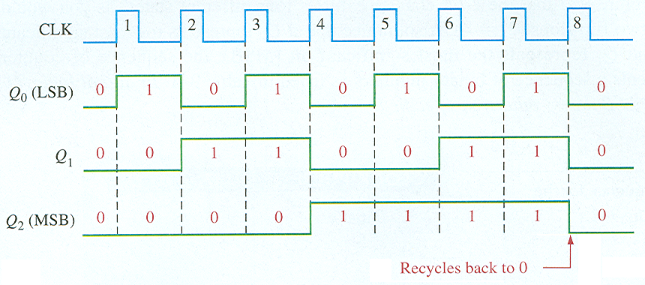
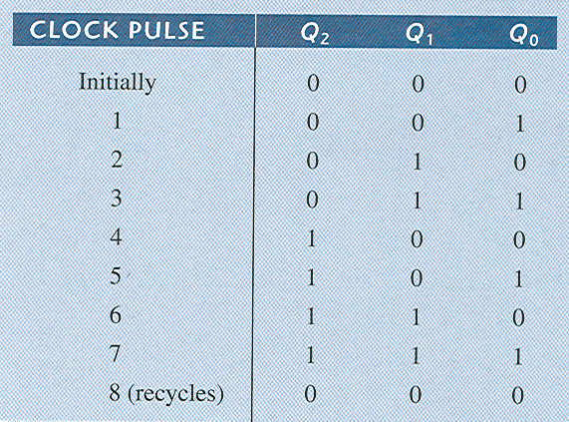
Asynchronous Counter Operation
3-bit asynchronous binary counter

Slide 8
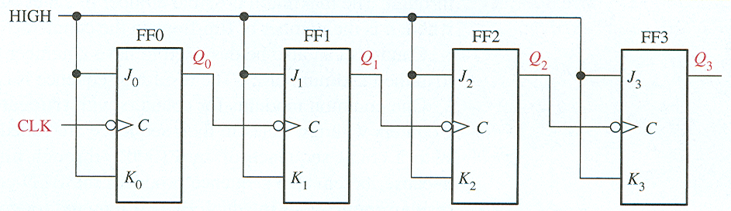
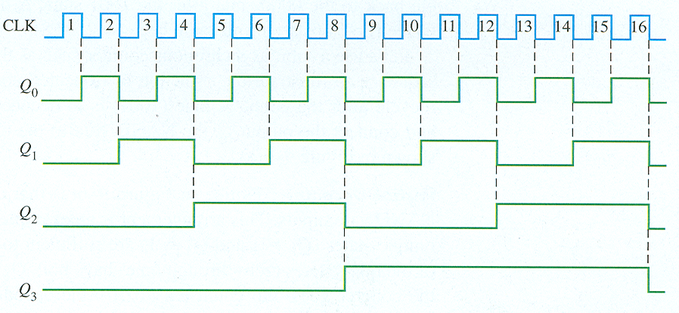
Asynchronous Counter Operation
4-bit asynchronous binary counter

Slide 9
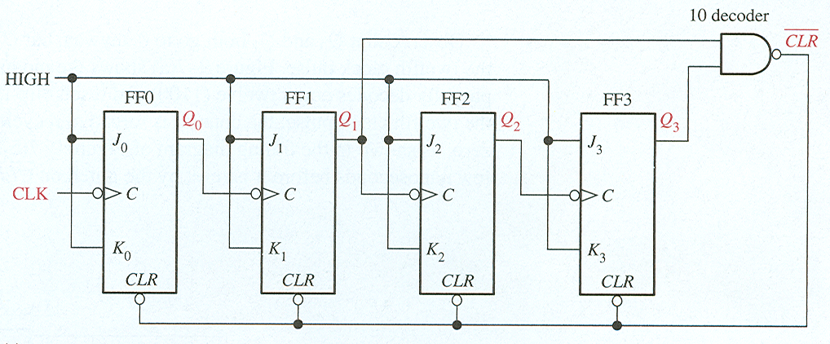
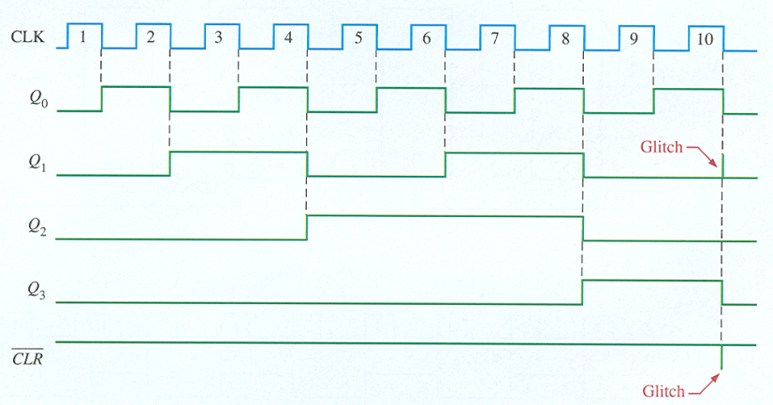
Asynchronous Counter Operation
Asynchronous decade counter

Slide 10
Asyn. Counters with MOD no. < 2^{n}
Example (cont’d):
C
B
A
Q
J
Q
J
Q
J
All J, K inputs are 1 (HIGH).
CLK
CLK
CLK
Q
K
Q
K
Q
K
CLR
CLR
CLR
B
C
1
2
3
4
5
6
7
8
9
10
11
12
MOD-6 counter produced by clearing (a MOD-8 binary counter) when count of six (110) occurs.
Clock
A
B
C
NAND
Output
1
0

